Slide 1
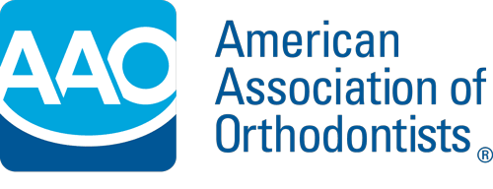
Spring 2024 Technology Survey
Draft Report
April 19, 2024

Slide 2
Research Objectives & Methodology
The objective of this survey is to determine member usage of various orthodontic technologies and determine barriers to entry for those that are not using technologies.
With regards to the survey, the AAO would like to examine the adoption of technology by its members:
Determine what percentage of members are currently using each technology;
For 3D printers, learn what purpose(s) members are using the printers for;
Learn how many members are considering adopting each technology in the future;
Collect feedback on the perceived barriers to members adopting each technology.
Technologies that were asked about in the survey included 3D printers, CBCT, intraoral scanners, digital indirect bonding, custom bracket systems, remote treatment monitoring, robotic aligner trimmer, robotic wirebender, tooth movement software, and digital workflow software.
Questions were drafted by AAO. On March 19, 2024, an email invitation was sent to practicing members in the U.S. (n=9,164) and Canada (n=437). A reminder email was sent on March 25, 2024. Data was gathered between March 19, 2024 and April 1, 2024.
There were a total of 850 usable responses for an 8.9% response rate: 798 in the U.S. (8.7%) and 52 in Canada (11.9%).
Comparisons stated in the report as significant are relative to the 95% confidence level.
  The precision of each question is approximately ± 3.2% but can vary depending on the number of responses to an individual question and the amount of agreement to the question.
Notes:
2

Slide 3
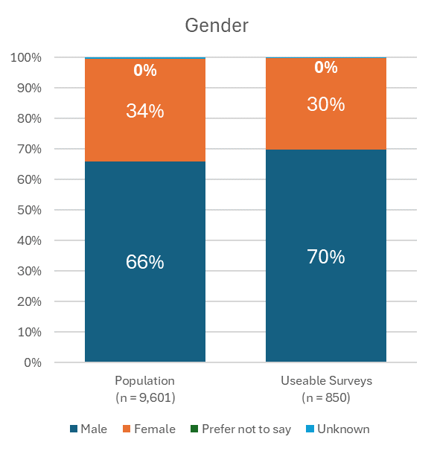
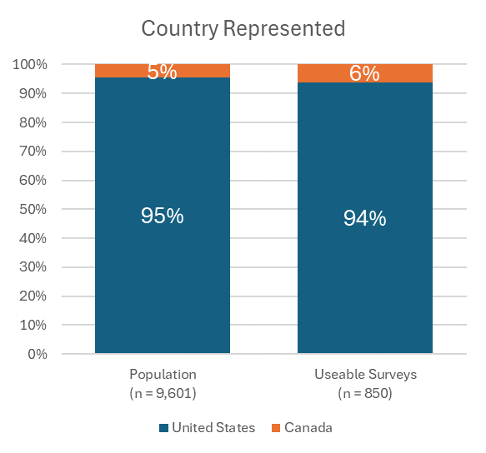
Sample Representativeness
Compared to AAO Membership Population
Male members were more likely to complete the pulse survey than female members. This is consistent with previous surveys.
Members from Canada were slightly more likely to respond than those from the United States, although the difference is not significant.
Notes:
3

Slide 4
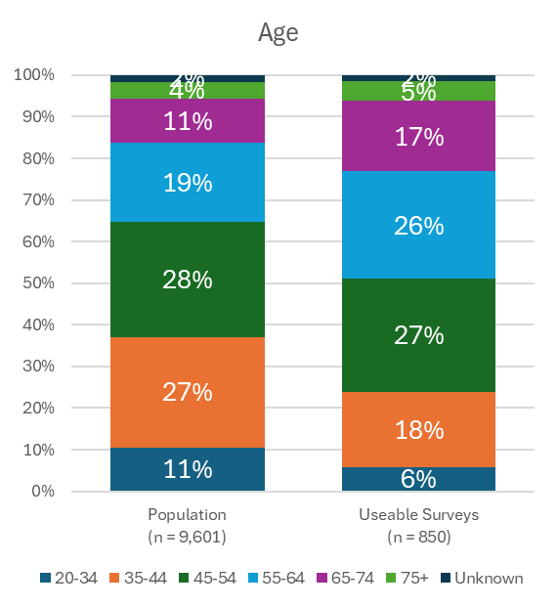
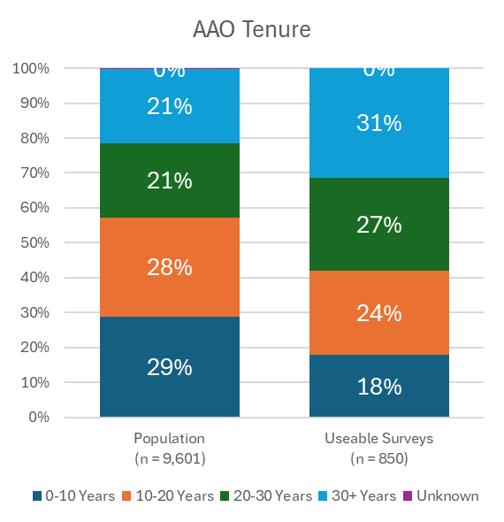
Sample Representativeness
Compared to AAO Membership Population
Younger members and members with less tenure as an AAO member were much less likely to respond than older members and those with a longer tenure as an AAO member. This is consistent with previous surveys.
Notes:
4

Slide 5
Research Summary

Slide 6
Research Summary
Of the technologies included in the survey, intraoral scanner is the only one currently used by a majority of respondents (91%).
The next most commonly used technologies were 3D printers (43%) and CBCT (42%).
Robotic aligner trimmers and robotic wirebenders were the least used technologies with less than 10% of respondents using these technologies.
Nearly all respondents using 3D printers do so for models for aligners (96%) while 55% use 3D printers for models for limited clear aligner cases.
Those who use 3D printers for retainers but not for aligners provided a variety of reasons for this behavior with no consensus reason.
Respondents generally indicated they are not currently considering or actively implementing new technologies except for an intraoral scanner where 42% of respondents are either considering or implementing it.

Slide 7
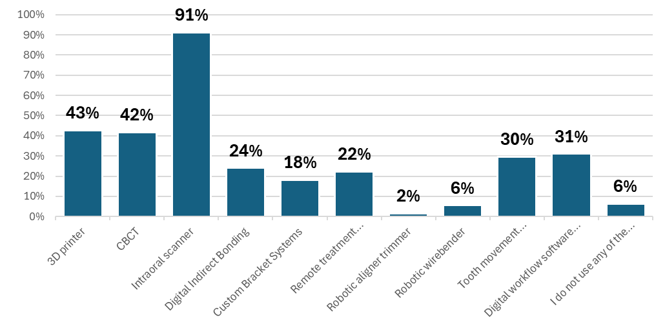
Use of Technologies
Among all respondents, an intraoral scanner is the only one currently used by a majority of respondents (91%).
Other technologies used by a significant portion of respondents include 3D printer (43%), CBCT (42%), digital workflow software (31%), and tooth movement software for in-house aligners (30%).
There is a weak trend of older members being less likely to be aware of the AAO’s state advocacy initiatives, but the trend is not statistically significant. nor is there a significant difference by age. The closest one to being statistically significant is for members over the age of 75 where only 47% were aware.
Male respondents were slightly more likely to use some of the technologies, specifically 3D printers, CBCT, tooth movement software for in-house aligners.
Usage of some technologies, especially 3D printers, CBCT, and digital workflow software, are more likely among respondents younger than age 55.
(n = 850)
Q1. Do you use the following technology in your practice (select all that apply)?

Slide 8
Use of Technologies
Respondents in an orthodontic owned practice modality were nearly twice as likely to use digital indirect bonding compared to those in a corporate (DSO/OSO) owned modality (26% vs 14%).
Respondents in non-traditional practice modalities (neither orthodontist owned nor corporate owned) are more likely to use a CBCT (66%) than corporate owned modalities (45%) or orthodontist owned modalities (39%).
Respondents in a corporate owned practice modality are less likely to use digital indirect bonding (14%) compared to orthodontist owned modalities (26%) and other modalities (28%).
Respondents in a corporate owned practice modality are also less likely to use tooth movement software for in-house aligners (19%) compared to orthodontist owned modalities (31%) and other modalities (30%).
The table below summarizes where there are differences in technology adoption by segment.
Segment: | 3D printer | CBCT | Digital Indirect Bonding | Custom Bracket Systems | Tooth movement software for in-house aligners
Independent Altruists | 37% | 37% | 24% | 18% | 26%
Business Builders | 53% | 43% | 30% | 22% | 47%
Corporate Friendlies | 44% | 58% | 14% | 12% | 21%
Newer Networkers | 51% | 60% | 34% | 28% | 38%
Q1. Do you use the following technology in your practice (select all that apply)?

Slide 9
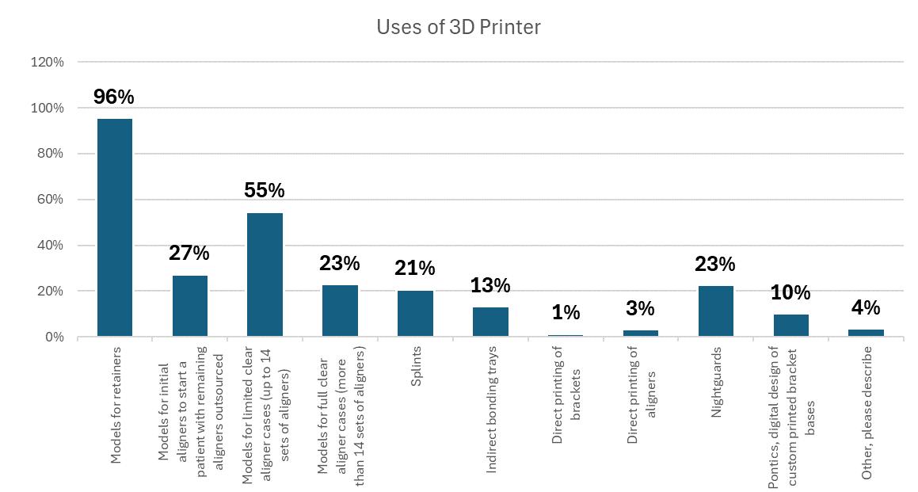
3D Printer Uses
The most common use of a 3D printer is to print models for retainers (96% of those using a 3D printer).
A slight majority (55%) of respondents using a 3D printer do so for models for limited clear aligner cases (up to 14 sets of aligners).
Several tasks are completed with 3D printers by 20-30% of respondents, including models for initial aligners to start a patient with remaining aligners outsourced, models for full clear aligner cases (more than 14 sets of aligners), nightguards, and splints.
(n = 362)
Q2. Do you print the following with your 3D printer (select all that apply)?

Slide 10
3D Printer Uses
Male respondents were more likely to use 3D printers to create models for limited clear aligner cases (58%), models for full clear aligner cases (27%), splints (25%), and nightguards (27%) than female respondents (47%, 13%, 10%, and 11% respectively).
Older respondents were more likely to use 3D printers to create models for full clear aligner cases, splints, indirect bonding trays, and nightguards than younger respondents.
Respondents from orthodontist owned practice modalities were more likely to use 3D printers to produce models for initial aligners to start a patient than respondents from other modalities.
Respondents from a corporate DSO/OSO practice modality were less likely to use 3D printers to produce models for both limited and full clear aligner cases than respondents from other modalities.
Respondents of the Corporate Friendlies segment are less likely to use 3D printers to produce models for initial aligners to start a patient and models for both limited and full clear aligner cases.
Respondents who also used either a robotic wirebender or a robotic aligner trimmer generally were more likely to use their 3D printer for each purpose than those who did not.
Q2. Do you print the following with your 3D printer (select all that apply)?

Slide 11
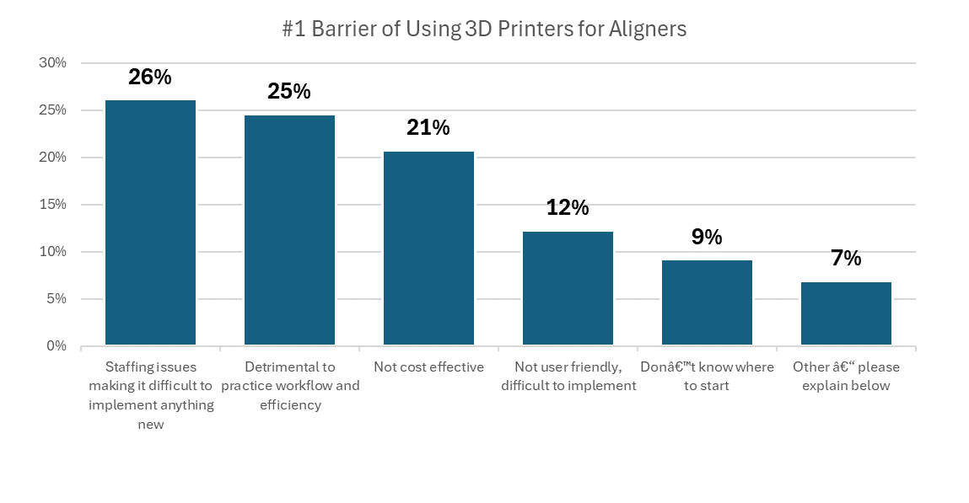
3D Printing Aligners Barriers
“Staffing issues making it difficult to implement anything new” (26%) was the most commonly selected number one barrier to implementing 3D Printers to fabricate aligners in-house among respondents, but was closely followed by “Detrimental to practice workflow and efficiency” (25%) and “Not cost effective” (21%).
Female respondents were much more likely to select “Not cost effective” (30%) as their top barrier than male respondents (17%).
(n = 130)
Q3. Rank the top 3 barriers of you fabricating aligners in-house.

Slide 12
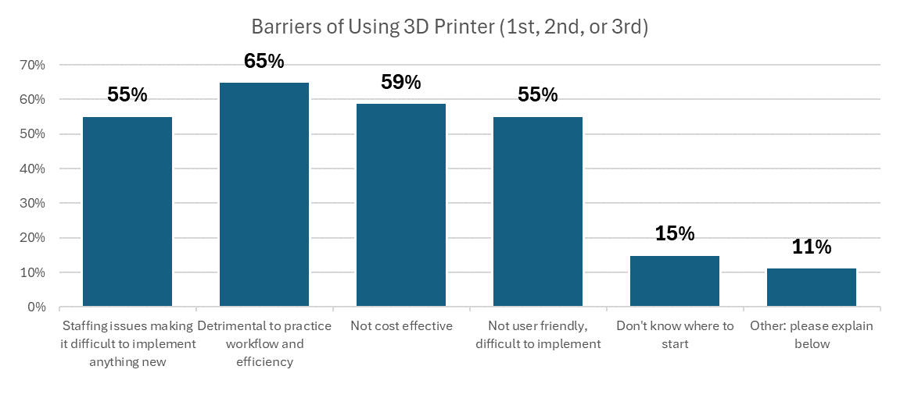
3D Printing Aligners Barriers
“Detrimental to practice workflow and efficiency” (65%) was the most commonly selected barrier to implementing 3D Printers to fabricate aligners in-house among respondents (as 1st, 2nd, or 3rd reason). It was closely followed by “Not cost effective” (59%), “Staffing issues making it difficult to implement anything new” (55%), and “Not user friendly, difficult to implement” (55%).
Respondents of an ethnic minority (any ethnicity other than white) were more likely to cite “Detrimental to practice workflow and efficiency” (91%) and “Not cost effective” (82%) as top 3 barrier than white respondents (61% and 56% respectively).
(n = 132)
Q3. Rank the top 3 barriers of you fabricating aligners in-house.

Slide 13
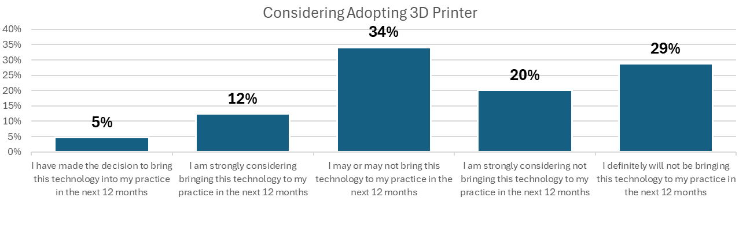
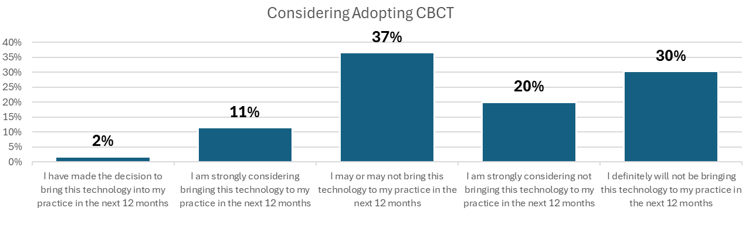
Considering Adopting Technologies
Less than 20% of those not using 3D printers are strongly considering or working to implement 3D printers.
Similarly, less than 20% of those not using CBCT are strongly considering or working to implement it.
(n = 452)
(n = 446)
Q4. How strongly are you considering the following technology for your practice?

Slide 14
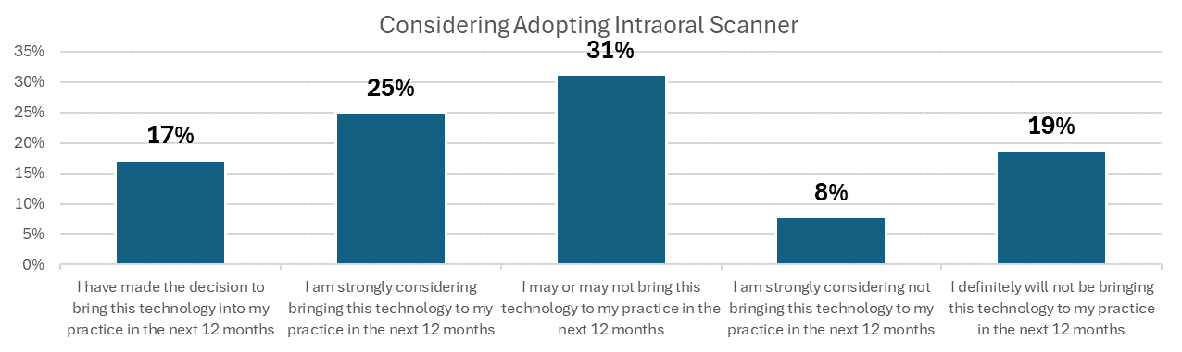
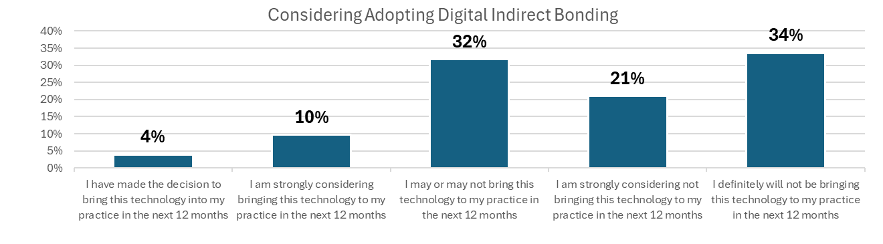
Considering Adopting Technologies
Nearly half (42%) of those not using an intraoral scanner are strongly considering or working to implement one.
14% of those not using digital indirect bonding are strongly considering or working to implement it.
(n = 64)
(n = 586)
Q4. How strongly are you considering the following technology for your practice?

Slide 15
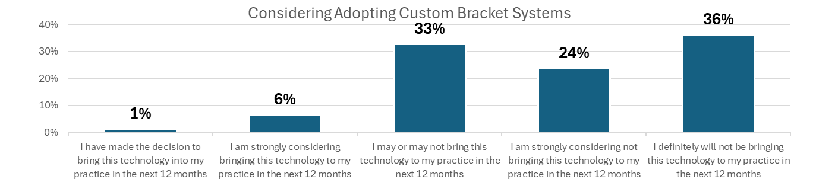
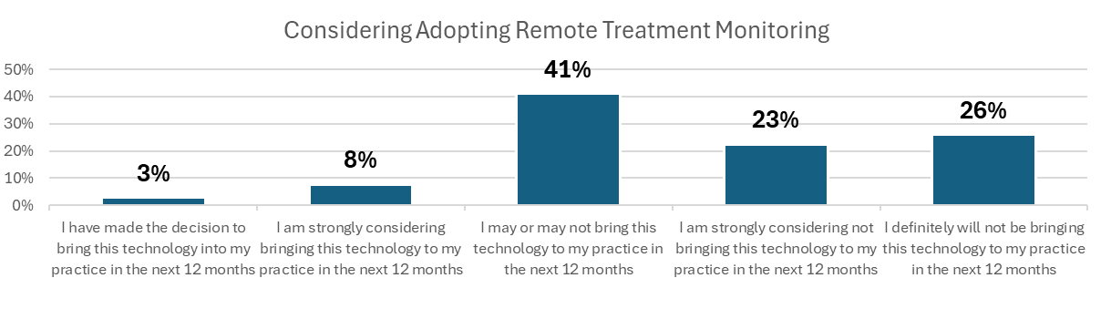
Considering Adopting Technologies
Less than 15% are strongly considering or working to implement either custom bracket systems or remote treatment monitoring.
Respondents who are strongly considering adopting digital indirect are much more likely to strongly consider adopting custom bracket systems (37%) than those who are not (3%).
Newer Networkers are more likely to consider Remote Treatment Monitoring (24%) than other segments (10%).
(n = 627)
(n = 595)
Q4. How strongly are you considering the following technology for your practice?

Slide 16
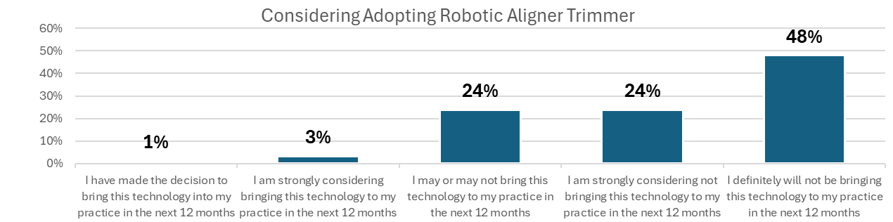
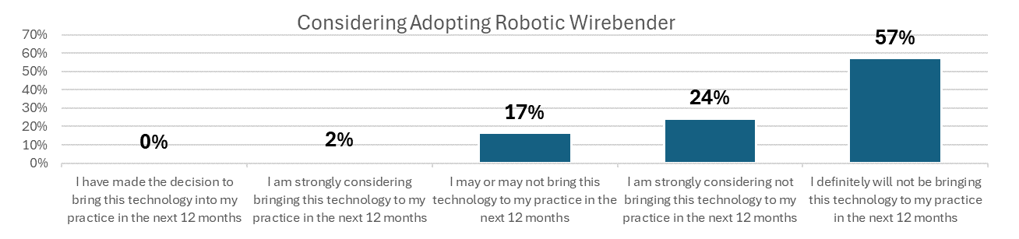
Considering Adopting Technologies
Less than 5% are strongly considering or working to implement either robotic aligner trimmer or robotic wirebender
Respondents who are strongly considering adopting robotic aligner trimmer are much more likely to strongly consider adopting robotic wirebender (14%) than those who are not (1%).
(n = 760)
(n = 721)
Q4. How strongly are you considering the following technology for your practice?

Slide 17
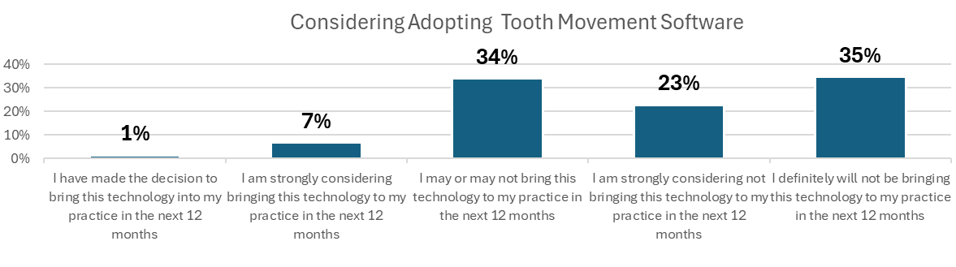
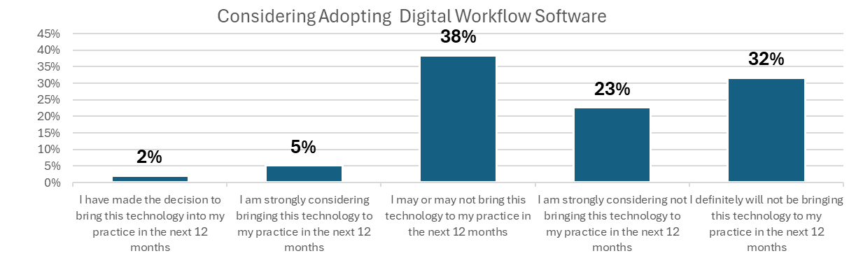
Considering Adopting Technologies
Less than 10% are strongly considering or working to implement either tooth movement software or digital workflow software.
Respondents under age 45 are more likely to be strongly considering digital workflow software (12%) than those age 45 or older (6%).
(n = 540)
(n = 528)
Q4. How strongly are you considering the following technology for your practice?

Slide 18
#1 Barrier to Adopting Technologies
For each technology asked, “Not cost effective” was the most commonly selected #1 barrier.
For 3D Printers, respondents under age 45 were less likely to select “Not cost effective” (27%) than those age 45 and older (36%).
For 3D Printers, Business Builder respondents were more likely to select “Staffing issues making it difficult to implement anything new” than the other segments.
For digital indirect bonding, members within 10 years of their orthodontic graduation date are more likely to select “Staffing issues making it difficult to implement anything new” than those more than 10 years from their orthodontic graduation.
Q5. Rank the top 3 barriers of you using technologies in your practice?

Slide 19
#1 Barrier to Adopting Technologies
For digital indirect bonding, Newer Networkers are much less likely to select “Not cost effective” (21%) as the other segments (46%).
For remote treatment monitoring, Newer Networkers were more likely to select “Staffing issues making it difficult to implement anything new” (30%) than respondents of other segments (11%).
For robotic wirebender, male respondents were more likely to select “Not cost effective” (64%) than female respondents (51%).
For robotic wirebender, older respondents were more likely to select “Staffing issues making it difficult to implement anything new”.
For robotic wirebender, Newer Networkers were more likely to select “Staffing issues making it difficult to implement anything new” (11%) than respondents of other segments (3%).
For tooth movement software for in-house aligners, respondents under age 45 were less likely to select “Not cost effective” (27%) than respondents age 45 and older (42%).
For tooth movement software for in-house aligners, Newer Networkers were more likely to select “Detriment to practice workflow and efficiency” (29%) than respondents of other segments (12%).
For digital workflow software, Corporate Friendlies were more likely to select “Staffing issues making it difficult to implement anything new” (18%) than other segments (11%).
For digital workflow software, Newer Networkers were more likely to select “Don’t know where to start” (46%) than other segments (24%).
Q5. Rank the top 3 barriers of you using technologies in your practice?

Slide 20
Top 3 Barriers to Adopting Technologies
When include the 1st, 2nd, and 3rd choice for barriers, “Not cost effective” is the most commonly selected barrier for each technology.
The only other barrier selected by a majority of respondents was “Staffing issues making it difficult to implement anything new” for 3D printers.
Q5. Rank the top 3 barriers of you using technologies in your practice?

Slide 21
Top 3 Barriers to Adopting Technologies
For CBCT, Newer Networkers were more likely to select “Staffing issues making it difficult to implement anything new” (47%) than other segments (26%).
For CBCT, Corporate Friendlies were less likely to select “Not user friendly, difficult to implement” (7%) than other segments (28%).
For intraoral scanners, Males were more likely to select “Detrimental to practice workflow and efficiency” (52%) than females (8%).
For robotic wirebender, Newer Networkers were more likely to select “Staffing issues making it difficult to implement anything new” (32%) than other segments (21%).
For tooth movement software, Independent Altruists were less likely to select “Detrimental to practice workflow and efficiency” (49%) than other segments (61%).
Q5. Rank the top 3 barriers of you using technologies in your practice?

